Slide 1
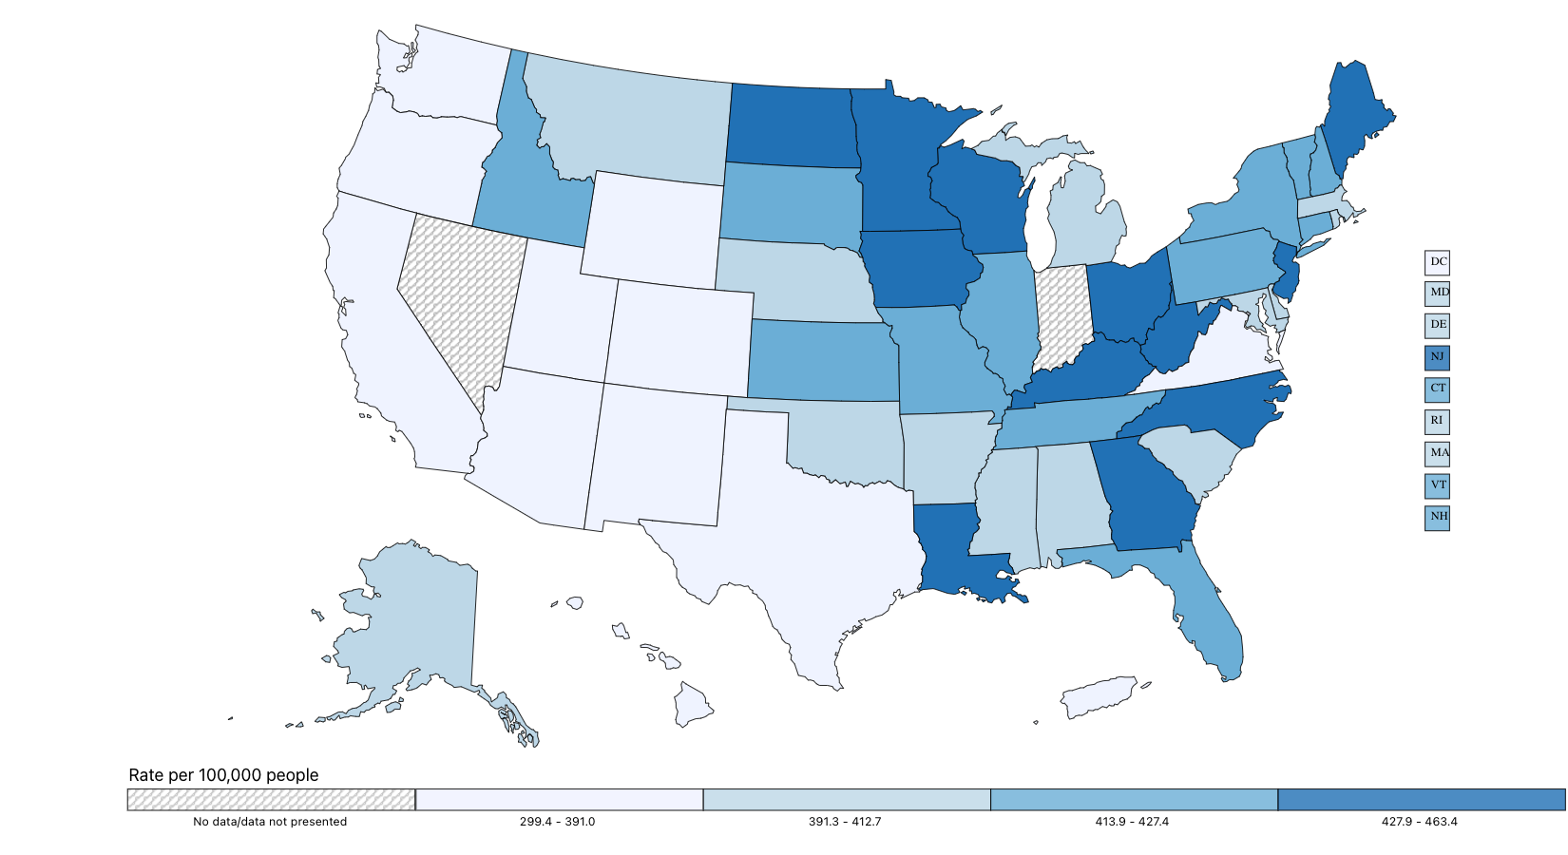
Rate of New Cancers in the United States, 2020
All Types of Cancer, All Ages, All Races and Ethnicities, Male and Female
Source - U.S. Cancer Statistics Working Group. U.S. Cancer Statistics Data Visualizations Tool, based on 2022 submission data (1999-2020): U.S. Department of Health and Human Services, Centers for Disease Control and Prevention and National Cancer Institute; https://www.cdc.gov/cancer/dataviz, released in November 2023.

